Slide 1
Data Design And Analysis
Design and Implementation of Relational Database for ISMT College

Slide 2
TASK 2 (A) Software Requirement Specification (SRS)
Requirements are those properties, constraints or functions that must be met to fulfill clients needs
Requirement document provides overview of outcome of system development and its requirements and without providing technical details.
Explains what system should do rather how it should do.
Explains purpose of system to be developed, its context, costs, future requirement, time scales and how the system will look like.
Analysis of requirement are gathered from critical study using several fact finding methods.

Slide 3
Fact Finding Methods
Fact finding is process of gathering required information for specific purpose.
Some Fact Finding Methods
Interview
Questionnaires
Record View
Observation and document checking

Slide 4
Interview
Interview is planned meeting with individual or group to collect required information
Questionnaires
Set of questions is distributed among stake holders.
Information is analyzed based on the response in questionnaire.

Slide 5
Record View
Different records such as attendance sheet, payment receipt, user logs, history data are analyzed.
Observation
Information is gathered by observing the area, document, website, work environment etc.

Slide 6
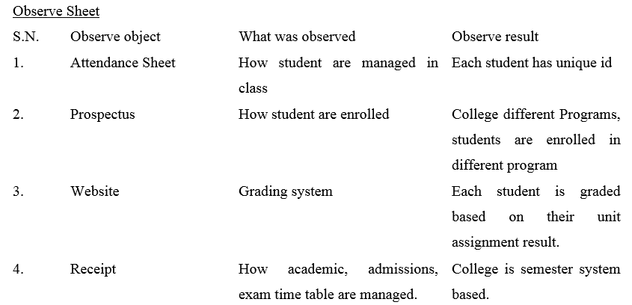
Observation Sheet

Slide 7
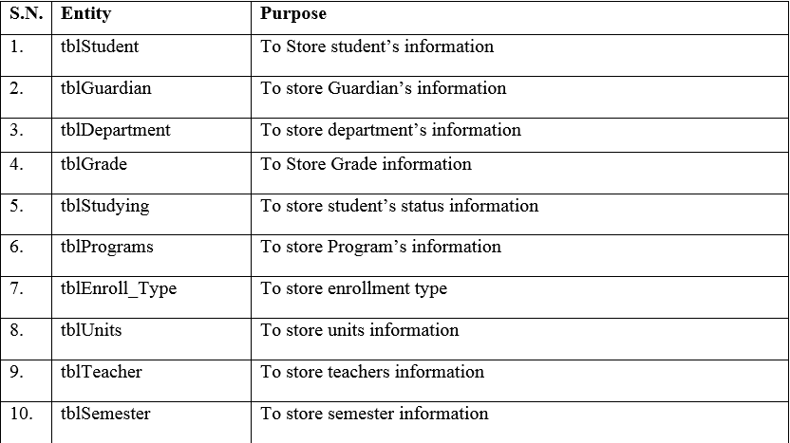
Relational Requirement

Slide 8
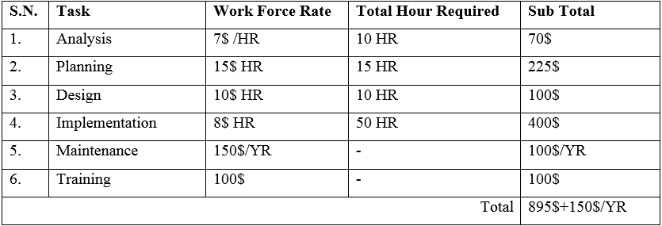
Cost

Slide 9
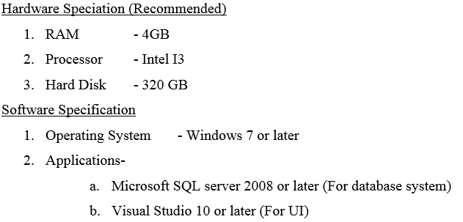
Technical Requirement
Future Requirement
Hard disk: If space in current hard disk fills
Training: User of the system in college needs training in time-to-time basis.
Annual Maintenance

Slide 10
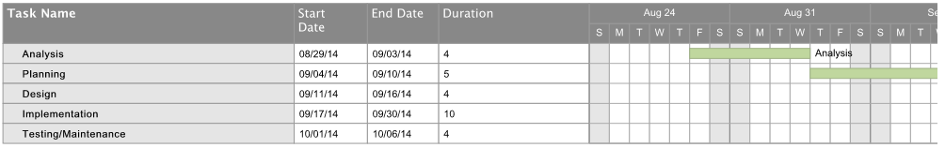
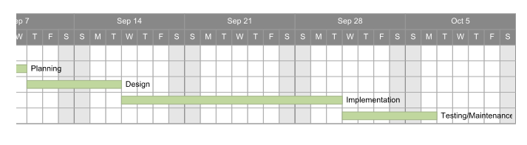
Time Scale

Slide 11
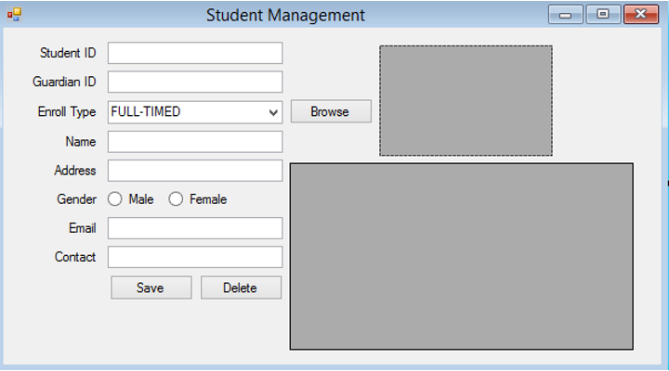
User Interface
User interface is designed using visual studio windows form.

Slide 12
System consists of these UI Forms
Main Form
Student Management
Teacher Management
Guardian Management
Faculty Management
Program Management
Unit Management
Grade Management
Enrollment Management
Enrollment Type Management
Semester Management

Slide 13
TASK 2 (B) SQL (Structured Query Languages
DDL (Data Definition Language)
It is basically used for creating, modifying and destroying a database and its objects.
DML (Data Manipulation Language)
Allows manipulating data in database and database objected created with DDL. Includes inserting, updating and deleting data from database and its objects.

Slide 14
DDL
Create
This is used for create new database or objects in database.
Create table tbl_Student (StudentID int not null , Name varchar(40),Address varchar (40));
Alter
This command is used for updating (modifying database elements)
Alter table tbl_student add constraint PK_ID primary key (StudentID);
Drop
Drop is used for either dropping (deleting) database or objects from it.
Drop table tbl_Student
StudentID | Name | Address

Slide 15
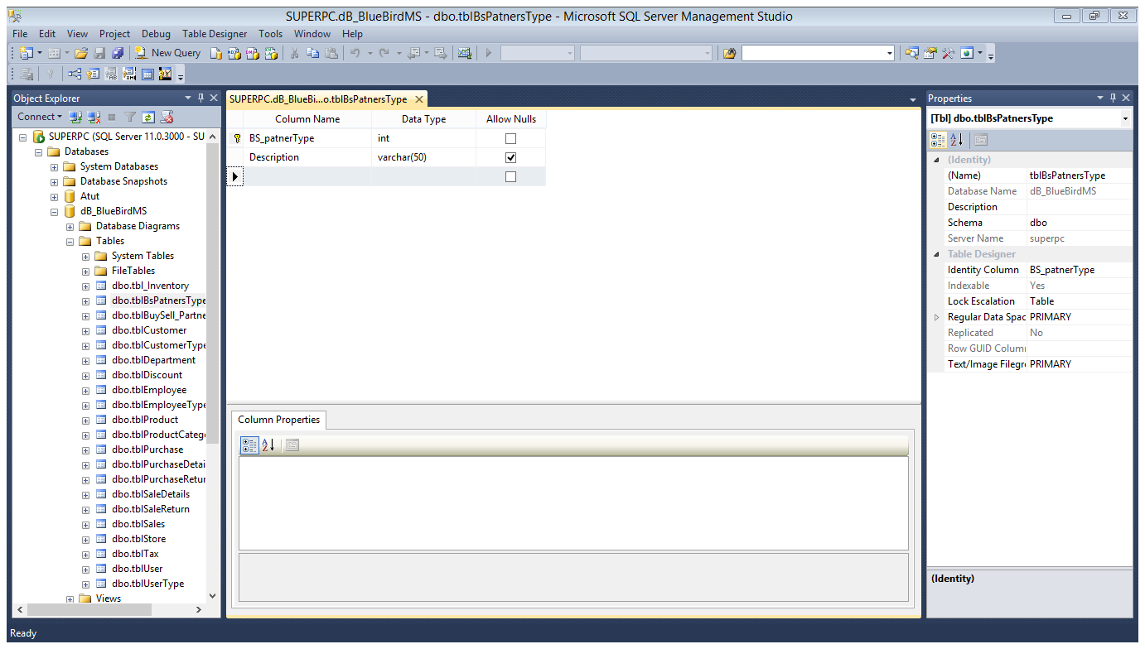
SQL Server Management Studio
SQL server management studio is a tool built for windows Computers that provides platform to manage databases.

Slide 16
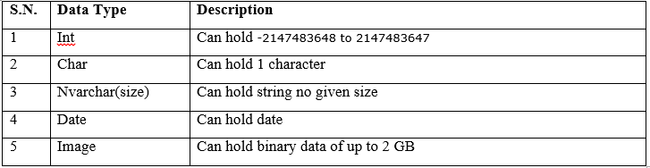
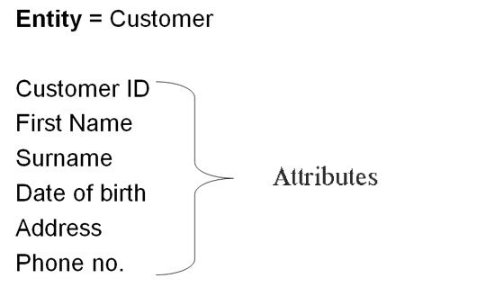
Data type, Entity and Attributes
Data type is something that describes what kind of data is that can hold.
Entity is object that can relate to real world such as student, teacher, program etc.
Meanwhile attributes are that property which describes entity.

Slide 17
Keys and Identifier
Keys are individual or set of attributes that ensure any record within a table can be uniquely identified.
Identifier is basically unique name of database, tables and attributes.
Domain and Referential Constraints
Keys are individual or set of attributes that ensure any record within a table can be uniquely identified.

Slide 18
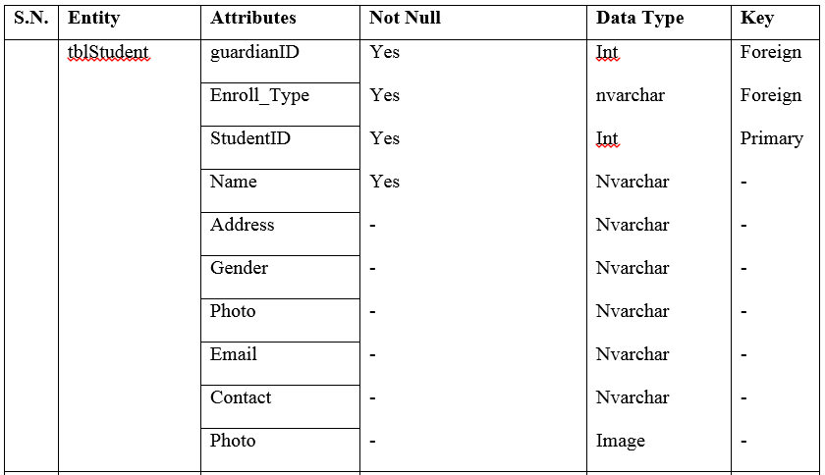
Building Relational Database for prepared design

Slide 19
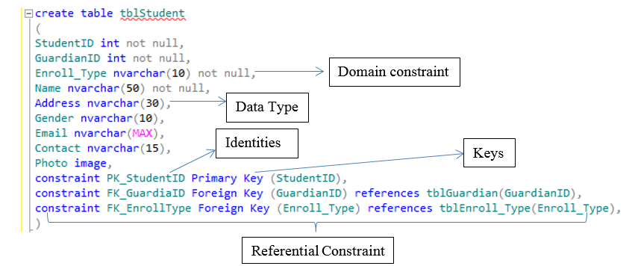
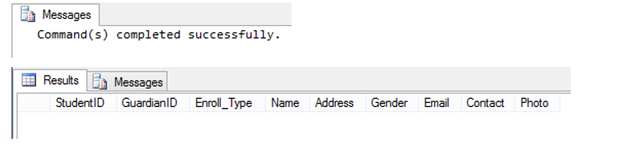
tblStudent
Result

Slide 20
Questions
Thank You

